Slide 1
Embry-Riddle ASCEND
Thomas Montano

Slide 2
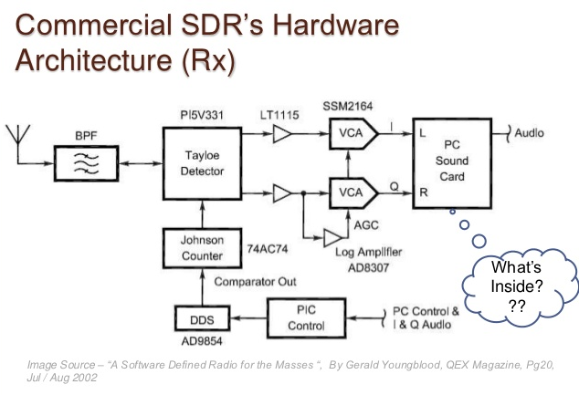
Project Goals
Demonstrate that Software defined radios can replace typical hardware-based systems
Demonstrate that SDR's will offer a higher performance, and lower developmental cost

Slide 3
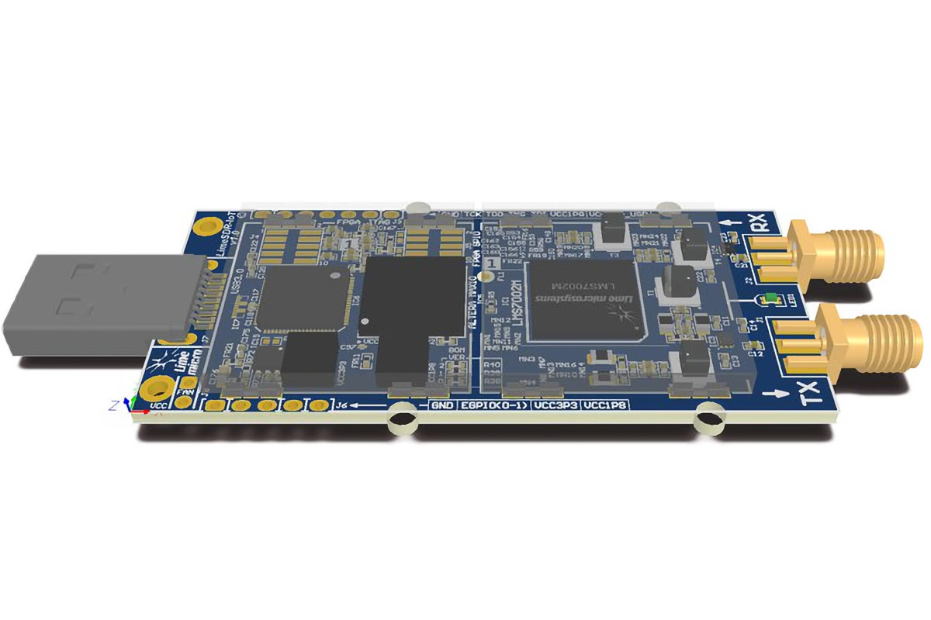
Software Defined Radio Transceiver
LimeSDR Mini
Allows flexibility and development
Programmed with GNU Radio

Slide 4
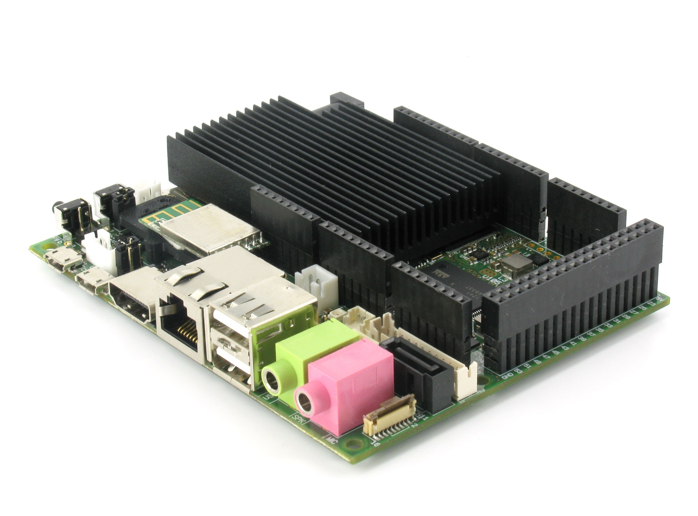
Onboard Computer
ARM Cortex-A9 Quad Core Processor and ARM Cortex-M3
76 GPIO Pins
Main digital signal processor

Slide 5
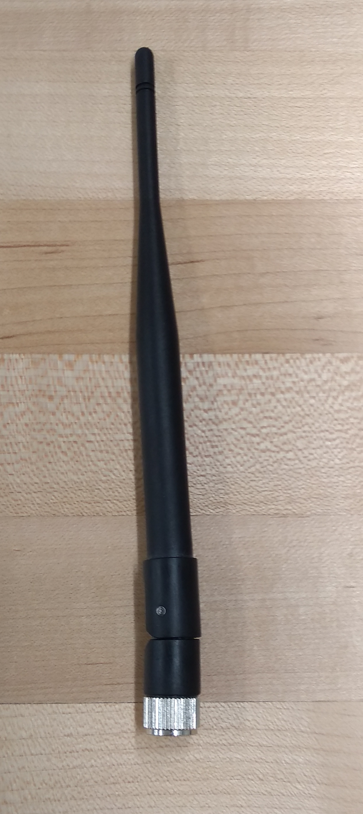
Onboard Antenna Characteristics
Two monopoles (SISO)
2 dBi total gain
Horizontal polarization

Slide 6
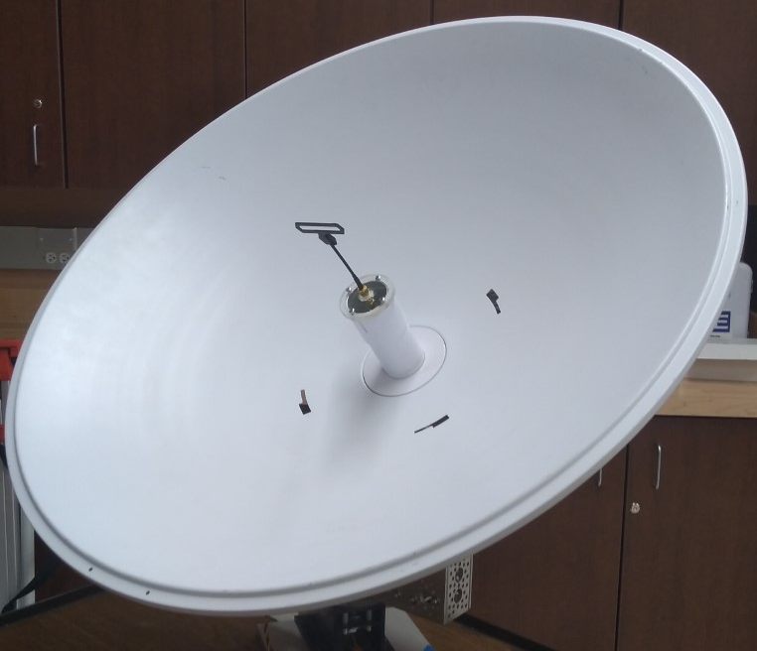
Ground Station Antenna Characteristics
Single Wavelength folded Dipole
24 dBi total gain
Horizontal polarization

Slide 7
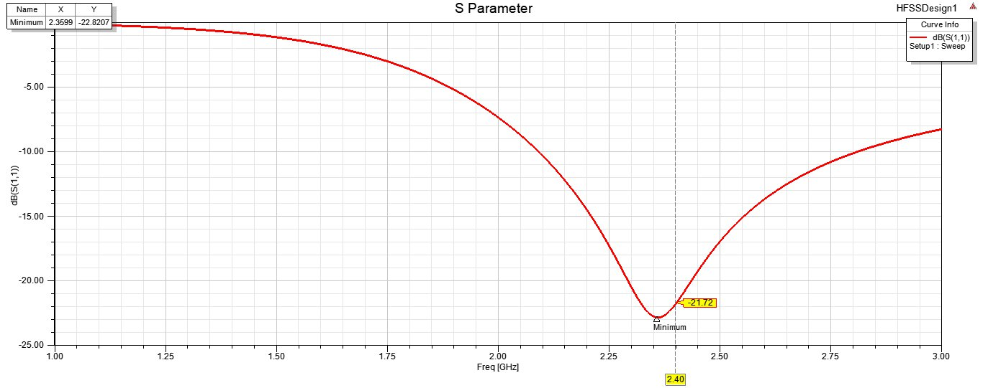
Monopole Antenna Resonance

Slide 8
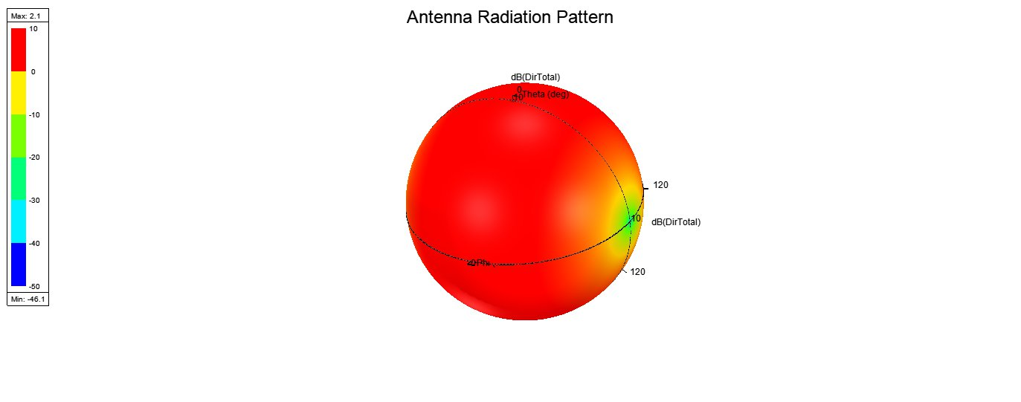
Monopole Antenna Gain

Slide 9
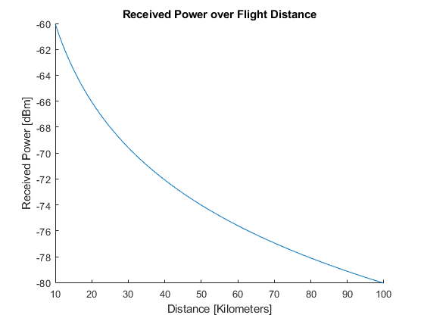
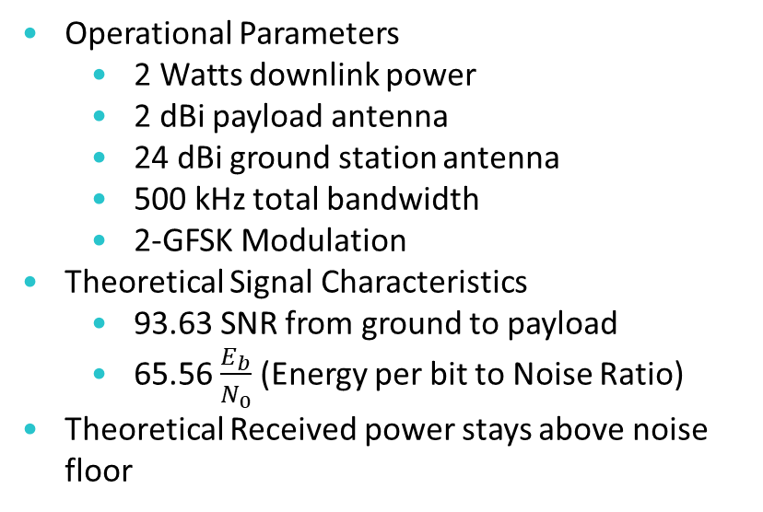
Link Budget
Operational Parameters
  2 Watts downlink power
  2 dBi payload antenna
  24 dBi ground station antenna
  500 kHz total bandwidth
  2-GFSK Modulation
Theoretical Signal Characteristics
  93.63 SNR from ground to payload
  65.56 $\frac{E_{b}}{N_{0}}$ (Energy per bit to Noise Ratio)
Theoretical Received power stays above noise floor

Slide 10
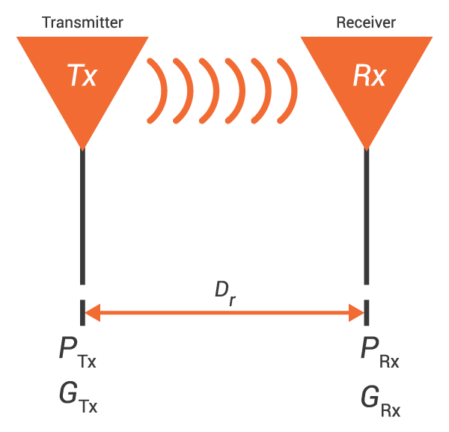
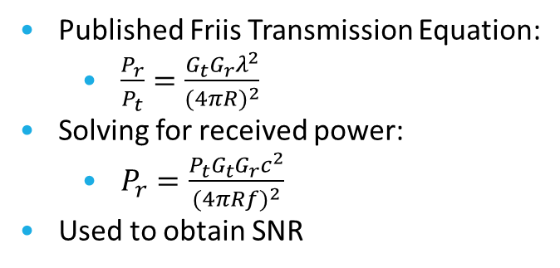
Signal Strength Theory
Published Friis Transmission Equation:
  $\frac{P_{r}}{P_{t}}=\frac{G_{t}G_{r}λ^{2}}{{(4πR)}^{2}}$
Solving for received power:
  $P_{r}=\frac{P_{t}G_{t}G_{r}c^{2}}{{(4πRf)}^{2}}$
Used to obtain SNR

Slide 11
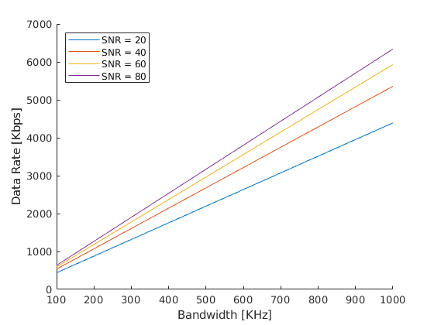
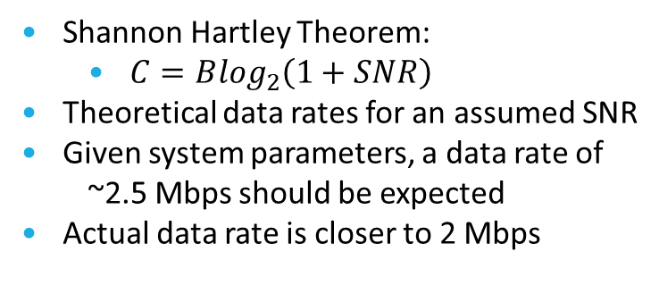
Data Rate Theory
Shannon Hartley Theorem:
  $C=B\log_{2}\left(1+SNR\right)$
Theoretical data rates for an assumed SNR
Given system parameters, a data rate of
~2.5 Mbps should be expected
Actual data rate is closer to 2 Mbps

Slide 12
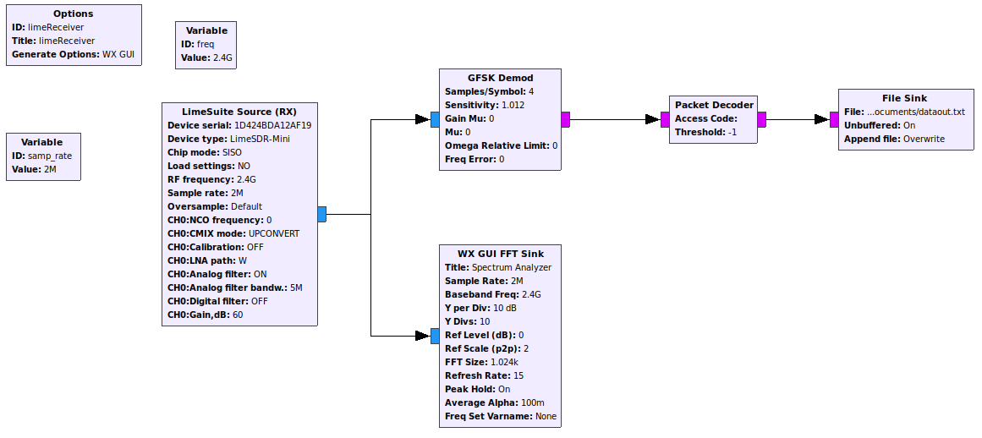
Receiver Flowchart

Slide 13
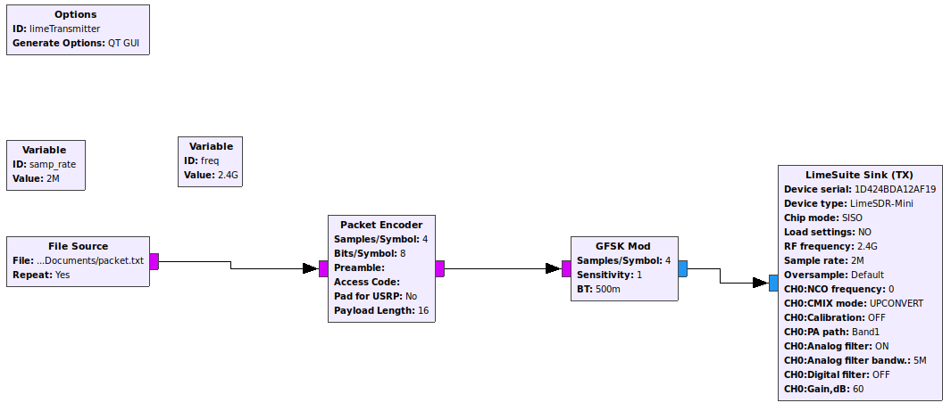
Transmitter Flowchart

Slide 14
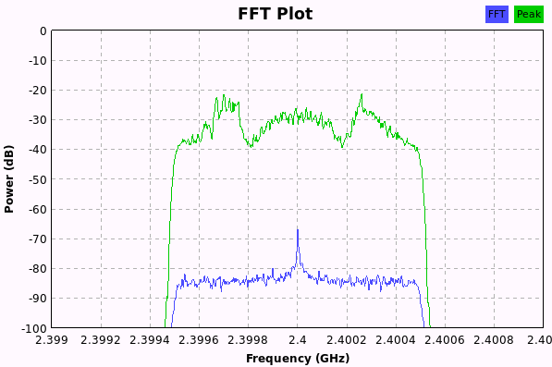
Experimental Results
Signal confirmation for 25 miles
Received power matches theoretical
Performance was equal to hardware system

Slide 15
Questions?

